Slide 1

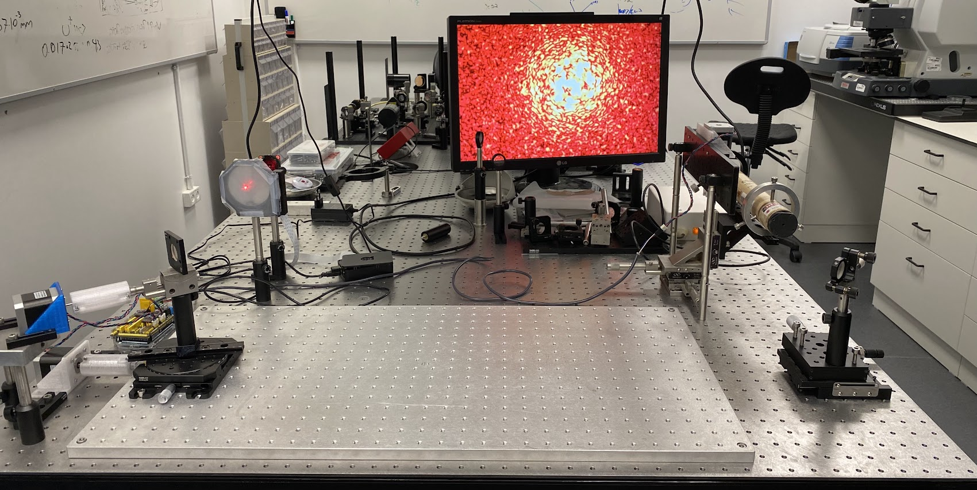
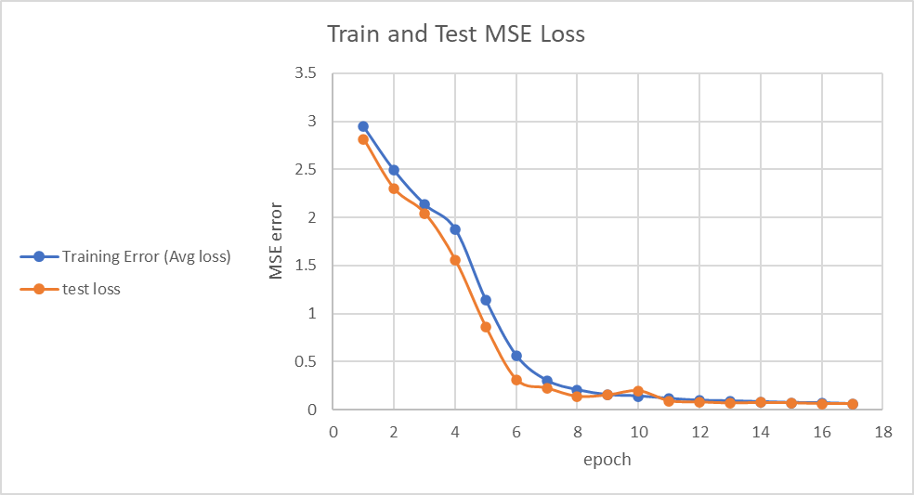
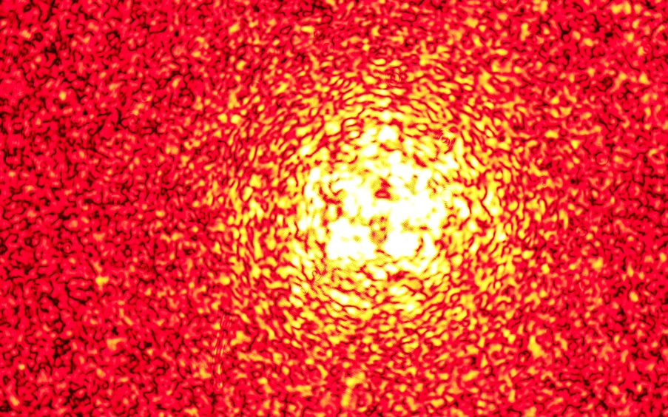
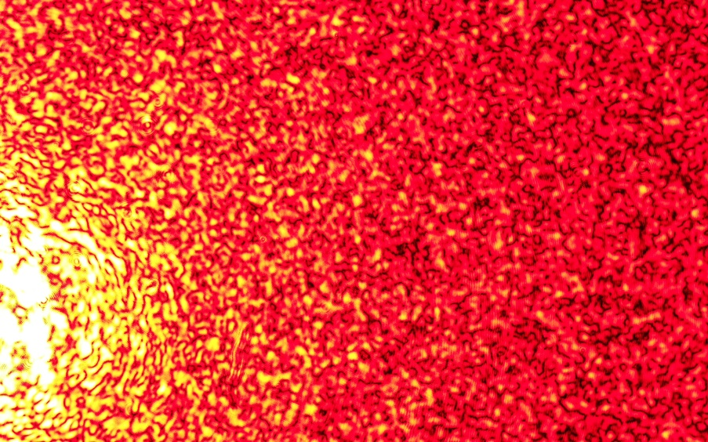
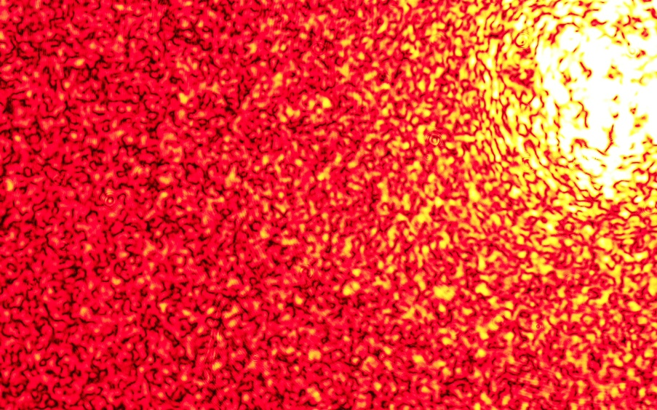
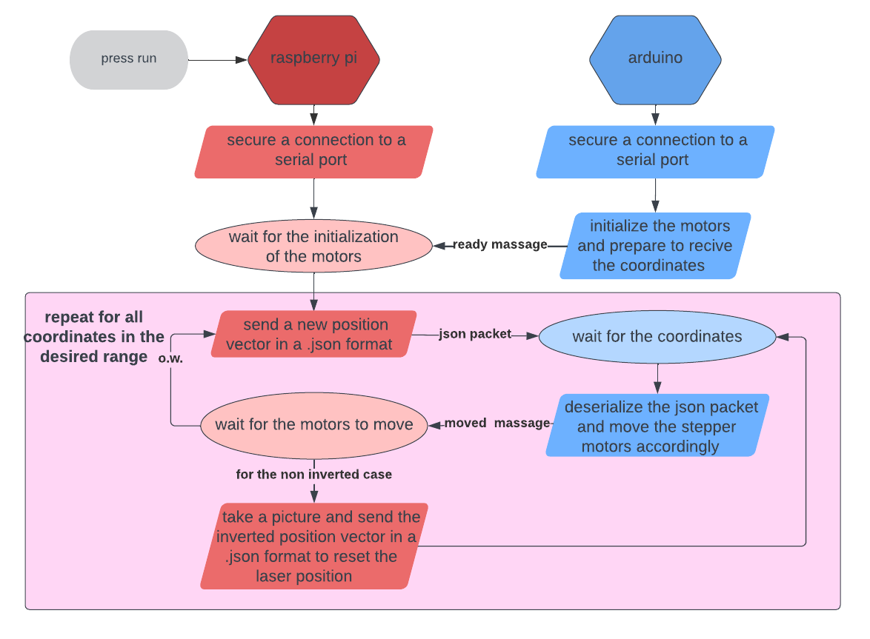
Laser Calibration
Project Number: 22-1-1-2456
Names: Almog Asher and Bar Zahavi
Advisor:Khen Cohen, Co-Advisor: Ofer Kfir
Introduction Our project is meant to be a breakthrough in the area of Laser Calibration – it suggests the possibility of calibrating a laser beam using only a single camera. The problem is as follows – laser calibration requires knowing precisely 4 coordinates of the beam – its X, Y location, and the angles for both axis. Nowadays if one wishes to calibrate a laser beam, it requires two High-resolution cameras – one for the angles and one for the X,Y location. Our project was meant to utilize two relatively new areas of research in order to reduce the number of cameras to one and simplify the problem – deep learning and speckle-images, that are images of the laser beam after passing through a dispersion field. Figure 1: speckle-images of different locations: $$\left(x=0,z=0,θ_{z}=0\right) \left(x=3,z=−2,θ_{z}=0\right) (x=−3,z=3,θ_{z}=0)$$ The coordinates values are in number of motor spins Objectives The first objective was to build a physical setup that allows us to move a laser beam in 4 degrees of freedom. The optical setup had to be built only using the equipment that was found in the lab and remained unused. The second objective was to make our system autonomous for two reasons: The first was to have the ability to collect a huge amount of data in a short time – supervised deep learning methods require a big amount of data, and we could only collect about 10 images per hour when moving the system manually. The second was to be able to build a feedback loop – after estimating the beam’s position, we want it to calibrate itself based on the estimation. The third objective was collecting the data and building a deep-learning network that would estimate the beam’s location. | Methods and implementation The physical setup Figure 2: the optical system: The physical setup is made of manual stages that were found in the lab and remained unused. We used stepper motors to convert the stages to autonomous ones, and 3D printing to create couplers and stands that would connect the motors to the stages. An Arduino is used to drive the motors, and a raspberry-pi 4 is used to take the speckle images. Data collection In order to collect a huge amount of data quickly and efficiently, we used serial communication between the Arduino and Raspberry-pi. Figure 3: raspberry-pi and Arduino communication schematic: | Observed automation benefits The automation of the system allowed us to collect about 450 images/hour, after being able to collect only 10 images/hour manually. We collected our dataset of 4400 images of hundreds of different coordinates in only one day. Deep learning network For the deep learning network, we used pyTorch’s resNet-18. We split our data to an 80% train data and 20% test data. We used an Adam optimizer and MSE loss as our criteria. Results Figure 4: an MSE loss graph for our train test data: We can observe that the MSE loss converges to zero for both the training samples and more importantly, the test images. Conclusions Firstly, the convergence of the model suggests that we achieved the main goal of this project – we’re able to predict the location of the laser beam based on only its speckle images. Secondly, we showed yet another proof that speckle images contain a lot of useful information about both the laser beam and the dispersion field, on the topography of it and the information on the incidence angle and the origin of the beam. Thus, we can suggest that further research with greater datasets should lead to the possibility of using this speckle-images based calibrating method in both research and commercial use. Bibliography [1] Laser speckle photometry – Optical sensor systems for condition and process monitoring- Lili Chen , Ulana Cikalova , Beatrice Bendjus , Andreas Gommlich , Shohag Roy Sudip , Carolin Schott , Juliane Steingroewer , Matthias Belting and Stefan Kleszczynski From the journal Materials Testing https://doi.org/10.3139/120.111308
The speckles image
camera
laser
Arduino
Dispersion field
Mirror 2
Raspberry pi
Mirror 1
Stepper motors

